Slide 1
Cloud and AZURE Services
Contents
1. Cloud Computing.
2. Cloud Computing Service Model
3. Basic Azure Services
4. Azure DevOps

Slide 2
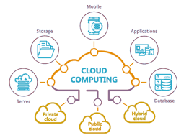
Cloud Computing
Cloud Computing is term referred to storing and accessing of data over the internet .
data backup, disaster recovery, email, virtual desktops, software development and testing, big data analytics, and customer-facing web applications.

Slide 3
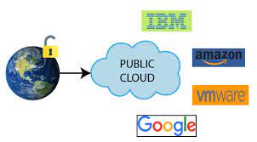
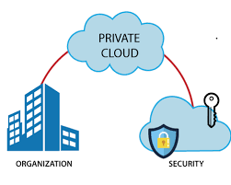
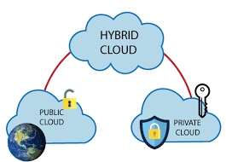
Types of cloud computing
Public Cloud
Private Cloud
Hybrid Cloud

Slide 4
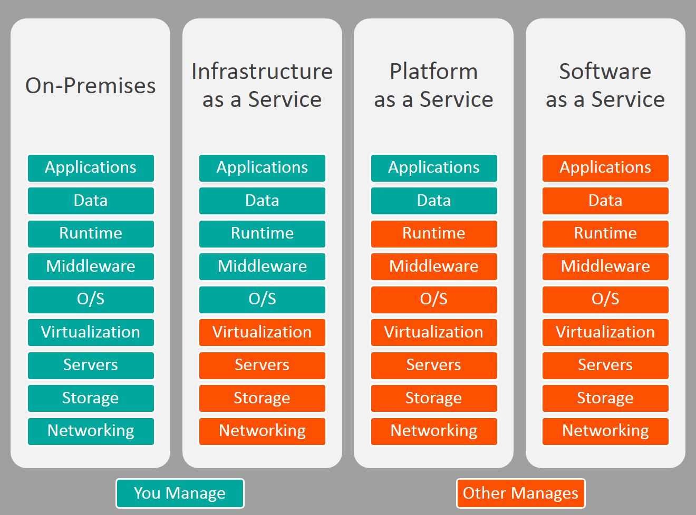
Cloud Computing Service Model

Slide 5
Basic Azure Services
1. VM
2.ARM
3.Storage
4.WEB App
5. Active Directory

Slide 6
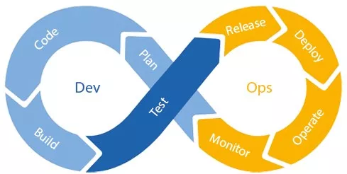
Azure DevOps

